Slide 1
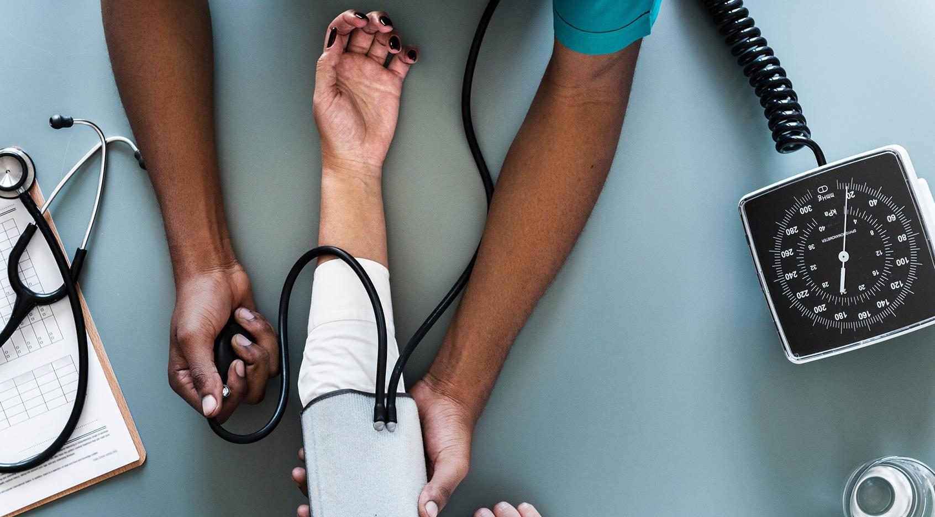

Ascites clinical cases
Dr/ Nourhan Mahmoud Abbas
Assistant lecturer of Tropical Medicine and Gastroenterology.

Slide 3
A 65 years old male patient, known to be HCV related liver cirrhosis presented to emergency room by hematemsis and melena.
Upper endoscopy done and showed esophageal varices grade III banded with PHG.
On examination
Pt conscious
BP 90/60
Pulse 110
Investigations
Hb level 6.8

Slide 4
Q1 what is your provisional diagnosis? 1 mark
Decompansated LC, LCF complicated by portal HTN
Q2 what is the case management? 1.5 marks
-Resuscitation(IV fluids,blood transfusion)
-Somatostatin, antibiotics
-Prophylactic carvid, antibiotics on discharge

Slide 5
Case 1
A 65-year-old man goes to his general practitioner (GP) complaining of increasing abdominal distension and anorexia of 4 weeks duration followed by 2 weeks of jaundice. He denies any weight loss, changes in bowel habits nor vomiting.
He takes no regular medications he has drunk beer for about 10 years, but stopped 10 days ago.
On examination:
He has 5 spider naevi on his upper chest wall.
Abdominal examination: reveals 6 cm firm palpable rt lobe of liver and
ascites is confirmed by shifting dullness
Investigations show :
raised bilirubin, thrombocytopenia, hypoalbuminemia.

Slide 6
Case 1
Diagnosis
Decompensated liver chirrhosis complicated with ascites
Management
abd us to confirm diagnosis
Ascitis fluid study
Control of ascites:
salt free diet, diuretics, TIPS and up to liver transplant

Slide 7
Case 2
A 55 years old male patient, presented to our Outpatient clinic with gradual increasing abdominal distention of 1 m duration associated with yellowish discoloration of sclera, dark colored urine and clay stool.
Patient also had significant weight loss over the last month.
On examination
Pt has jaundice, enlarged supraclavicular lymph nodes
Palpable gall bladder mass.
Ascites by shifting dullnes
Investigations
Hyperbilirubinemia mainly direct and hypoalbuminemia

Slide 8
Case 2
Diagnosis
malignant ascites
Management
Abd us/MSCT : showing biliary system, confirm mass, exclude mets, confirm ascites and detect abdominal lymphadenopathy
ERCP : to relieve biliary obstruction then surgical consultation

Slide 9
Case 3
A 65 years old male patient, known to be HCV related liver cirrhosis presented to emergency room by gradual disturbed conscius level.
Patient also has history of fever, abdominal pain and distention of 3 days durations.
on examination
Pt drowsy with flapping tremors
Jaundiced
Abdominal tenderness with ascites by shifting dullnes
Investigations
Leucocytosis ,Thrombocytopenia, hyperbilirubinemia and hypoalbuminemia

Slide 10
Case 3
Diagnosis
Pt mostly developed SBP which precipitate hepatic encephalopathy
Management:
-Ascitic fluid study (PMN count)
-Ascitic fluid culture (bedside test)
-Start antibiotics (cefotaxime/ceftriaxone)
-Salt free albumin if indicated
-Prophylactic antibiotics on discharge

Slide 11
Case 4
A 75 years old female patient, had HBV related liver cirrhosis presented to emergency room by gradual disturbed conscius level.
She was on regular medications: lactoluse syp, aldactone 400 mg/day and lasix 40 mg twice/day .
On examination
was hypotensive 70/40
Abdomen : dull flankes
No ll oedema

Slide 12
Case 4
Management:
Fluid resuscitation
Correct electrolyte imbalance
Anti encephalopathy measures
Adjust diuretics dose on discharge

Slide 13


